Slide 1

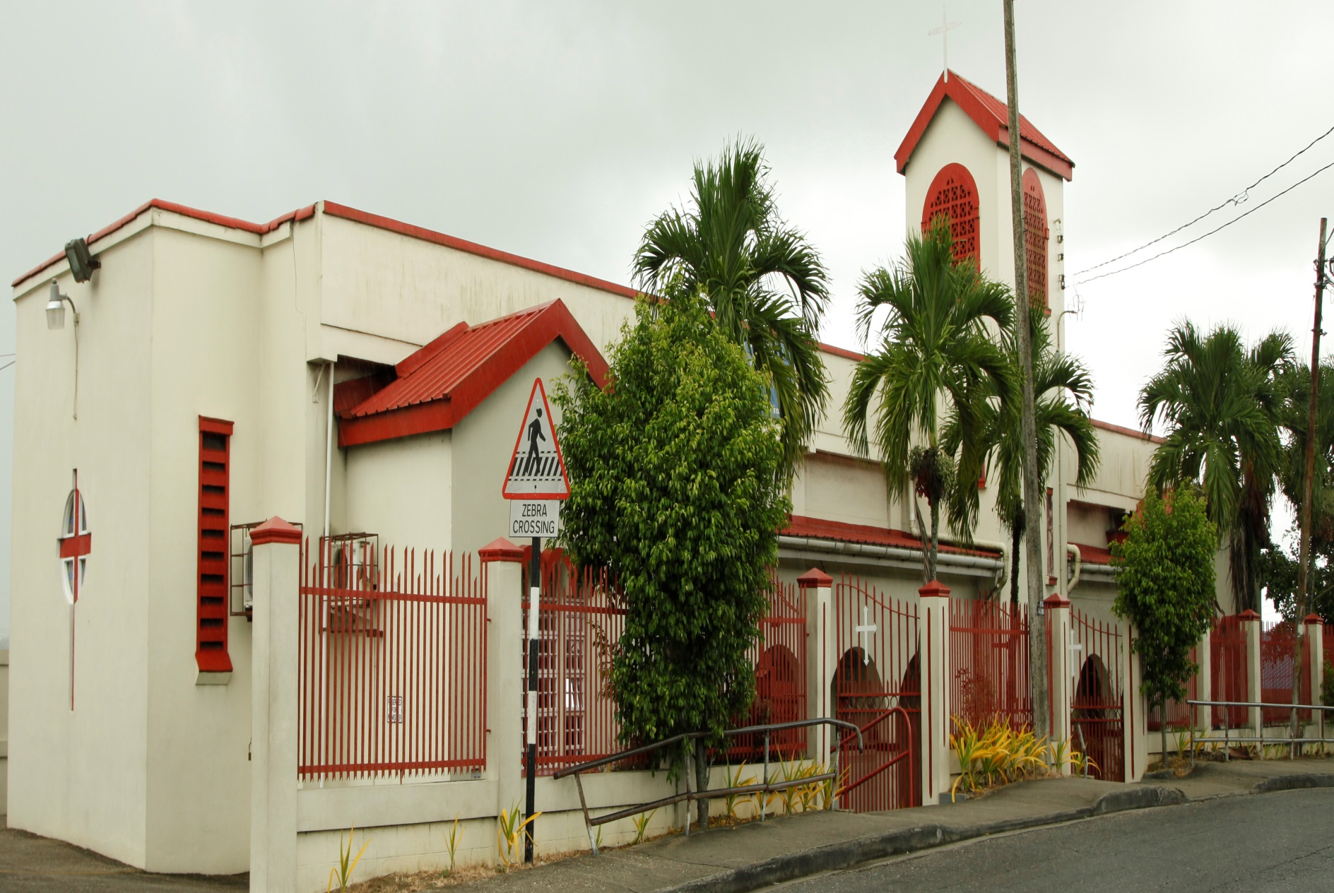

ST. ANDREW’S PRESBYTERIAN
CHURCH
1876 to 2020
Celebrating 144 years
of Christian Witnessing

Slide 2
The first building was completed in July 1876.
This building served a dual purpose: as a church and a day school.

Slide 3
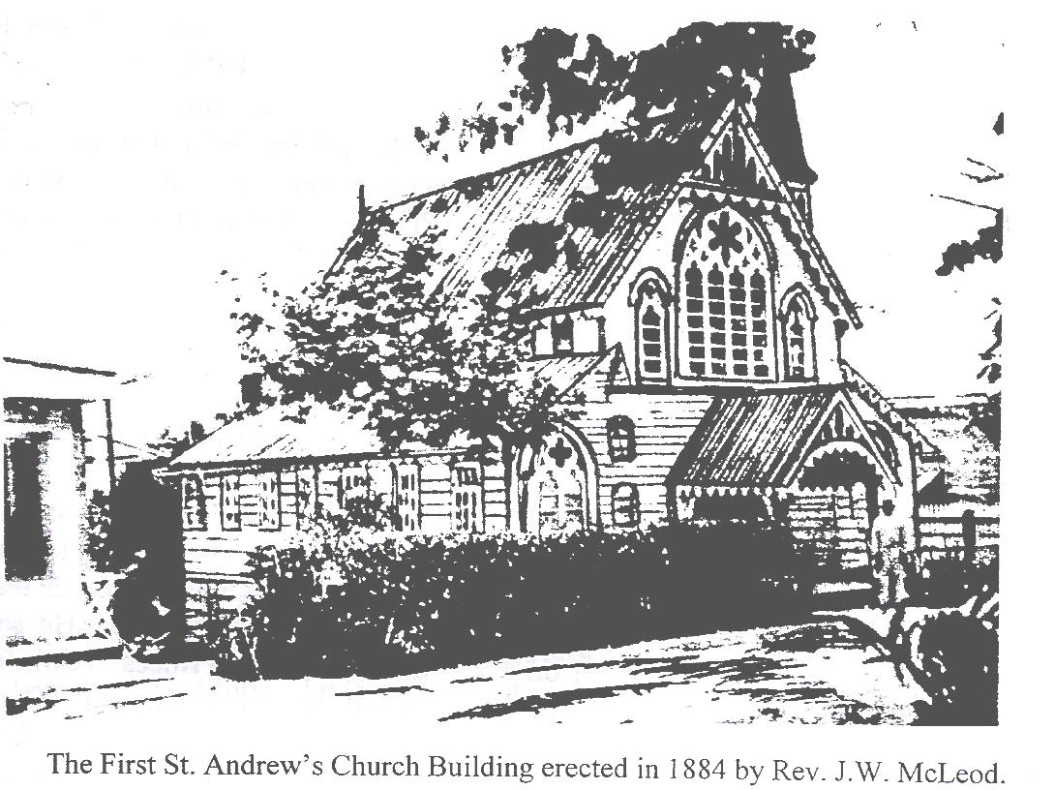
The first St. Andrew’s Church Building erected in 1884
by Rev. J.W. McLeod

Slide 4
In 1880 the first group of elders was installed.
Rev. Morton left in that same year.
Rev. J.W. McLeod worked from 1880 to 1888

Slide 5
The church was given the name,
St. Andrew’s on 29th September, 1884.
Rev. McLeod was succeeded by
Rev. W.L. Macrae in 1889

Slide 6
The Golden Age
Rev. J.C. Mcdonald
1920-1929
A period of prosperity and spiritual growth

Slide 7
1952
Rev. A.C. Dayfoot and his family arrived.
Master designer and builder of the new church building
(current).

Slide 8
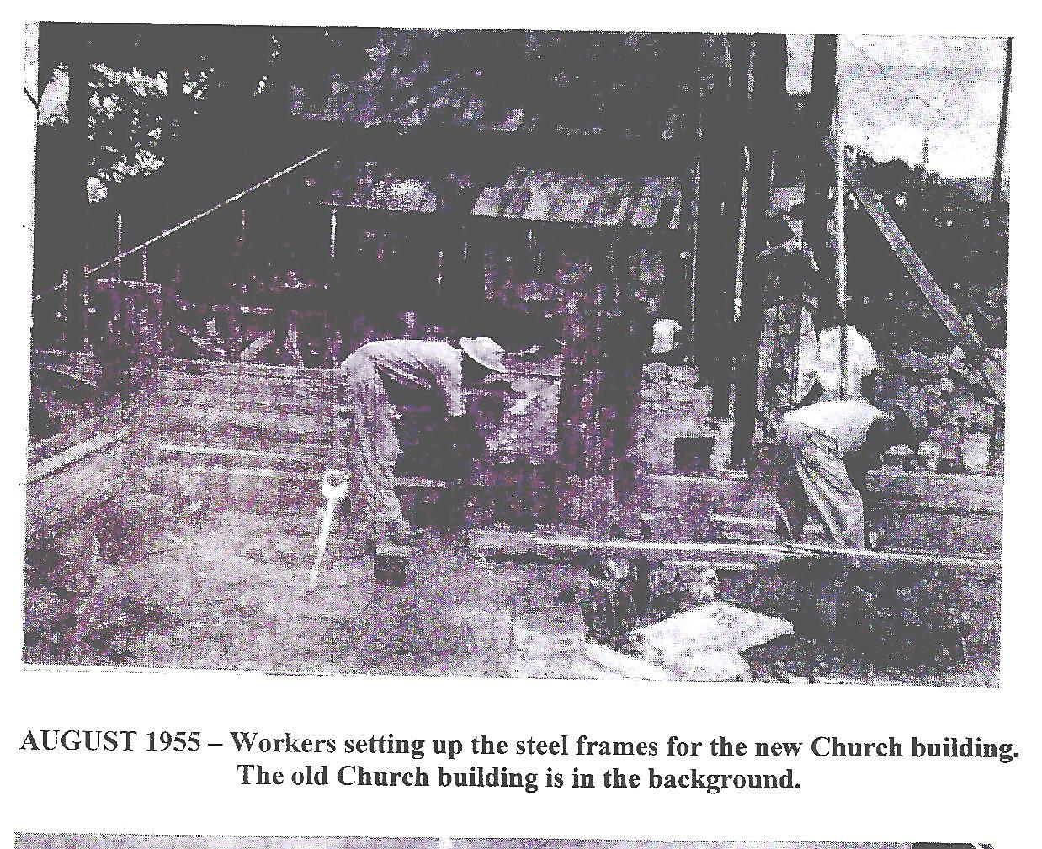
Construction of the new building

Slide 9
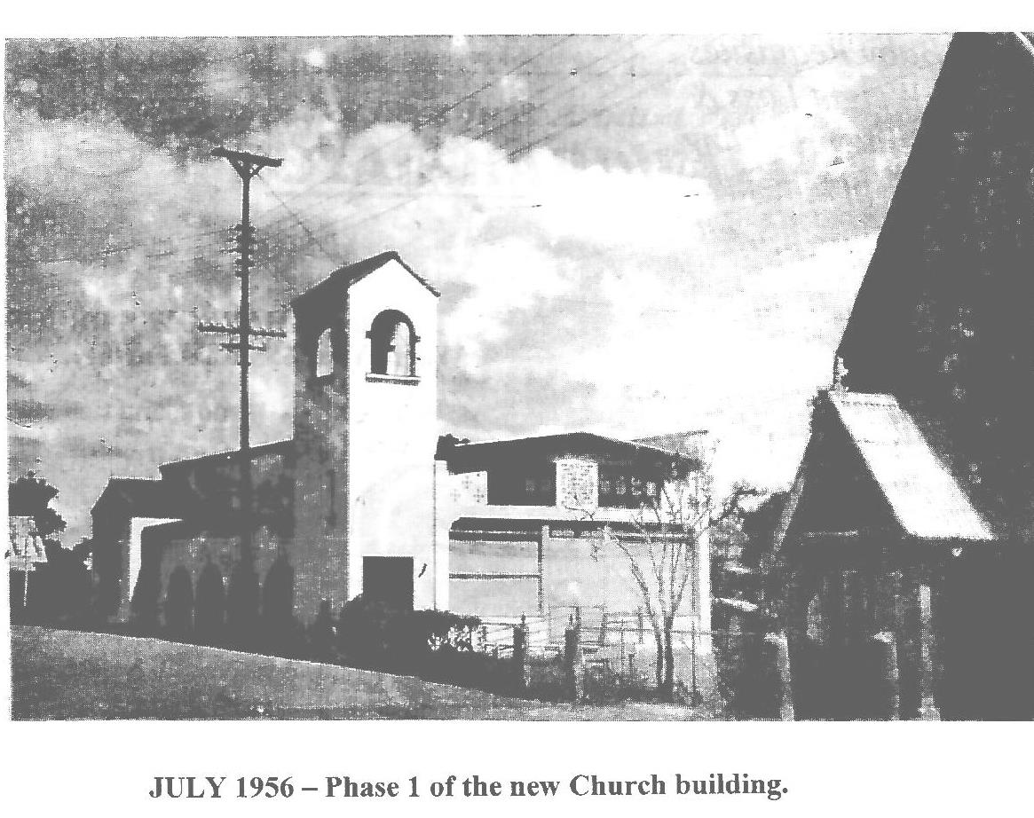
Completed Building

Slide 10
1973 to 1978
Rev Allison Ken Nobbee served the church.
The first Youth Group was formed on 25th October 1974.
Rev. Nobbee oversaw the completion of the church hall.
The Messengers emerged.

Slide 11
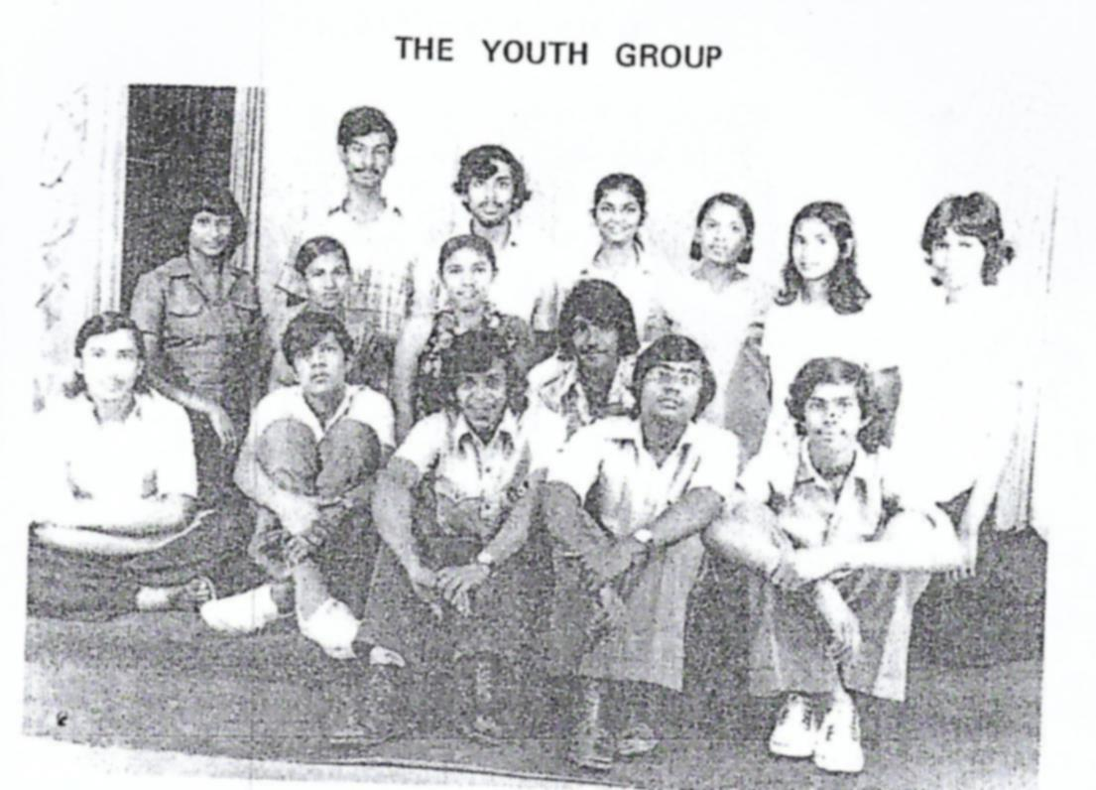
The Youth Group 1976

Slide 12
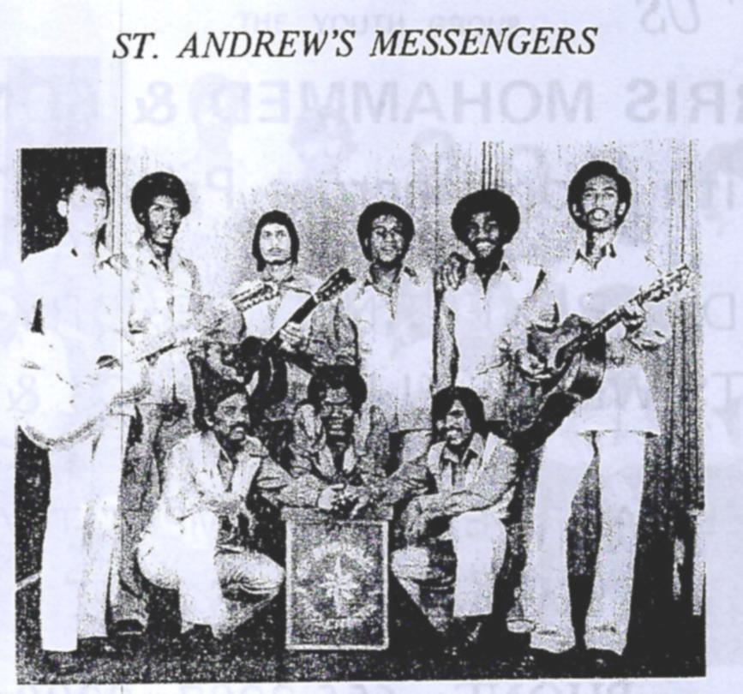
The Messengers

Slide 13
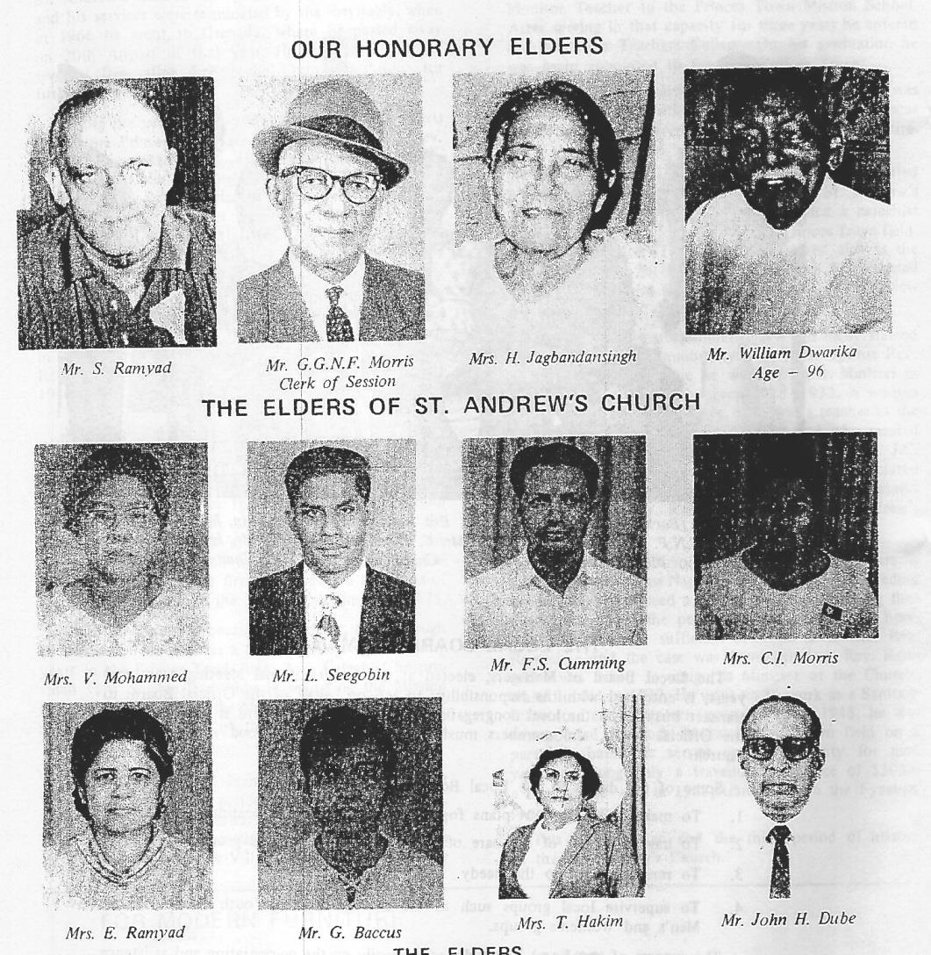
Elders in 1976

Slide 14
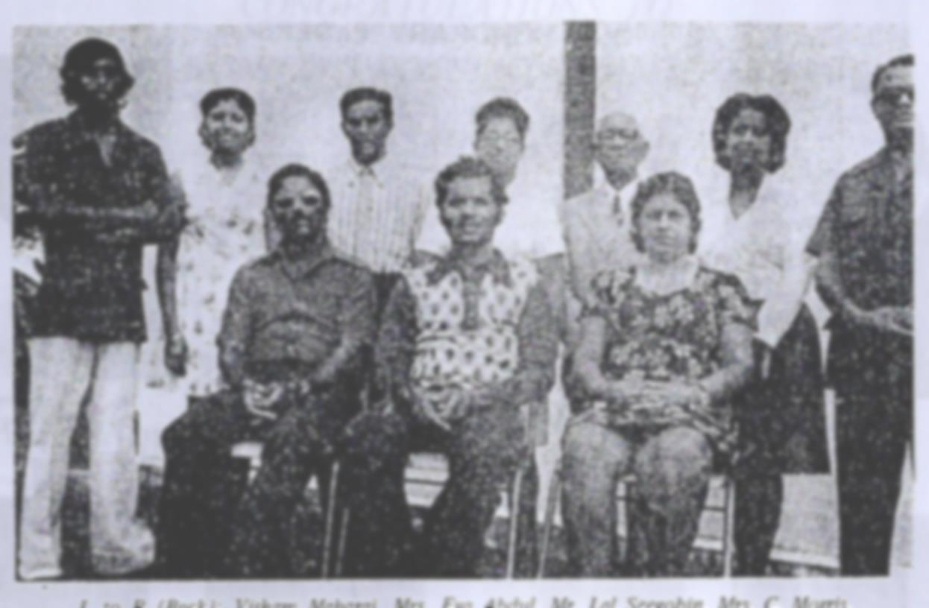
The Local Board 1976

Slide 15
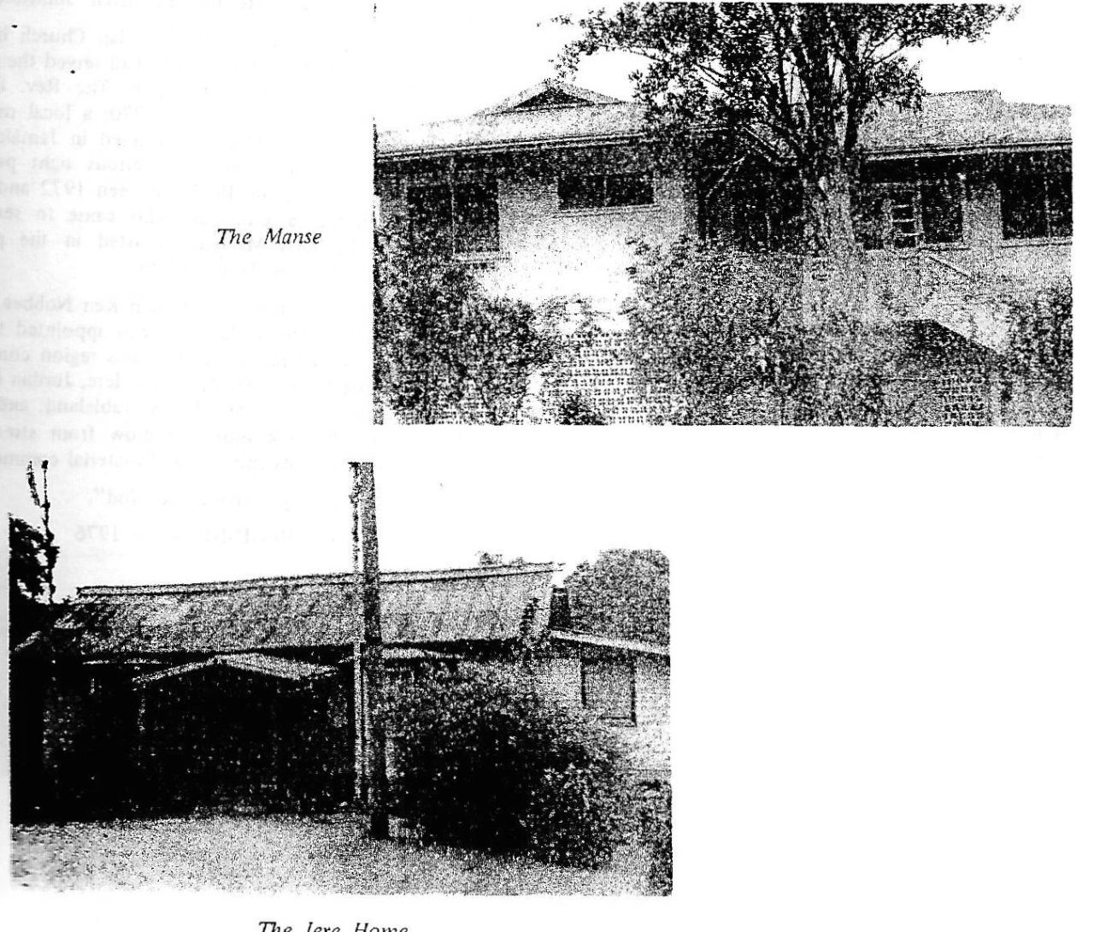
The Manse and Iere Home

Slide 16
1978 to 1981 –
Rev. Rawle Sukhu
1981 to 1989 – Rev. Victor Ramlal

Slide 17
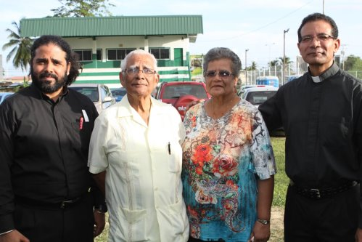
1989 to 1991 -
Rev. Winston Gopaul
1991 to 1995 –
Rev Everson T. Sieunarine

Slide 18
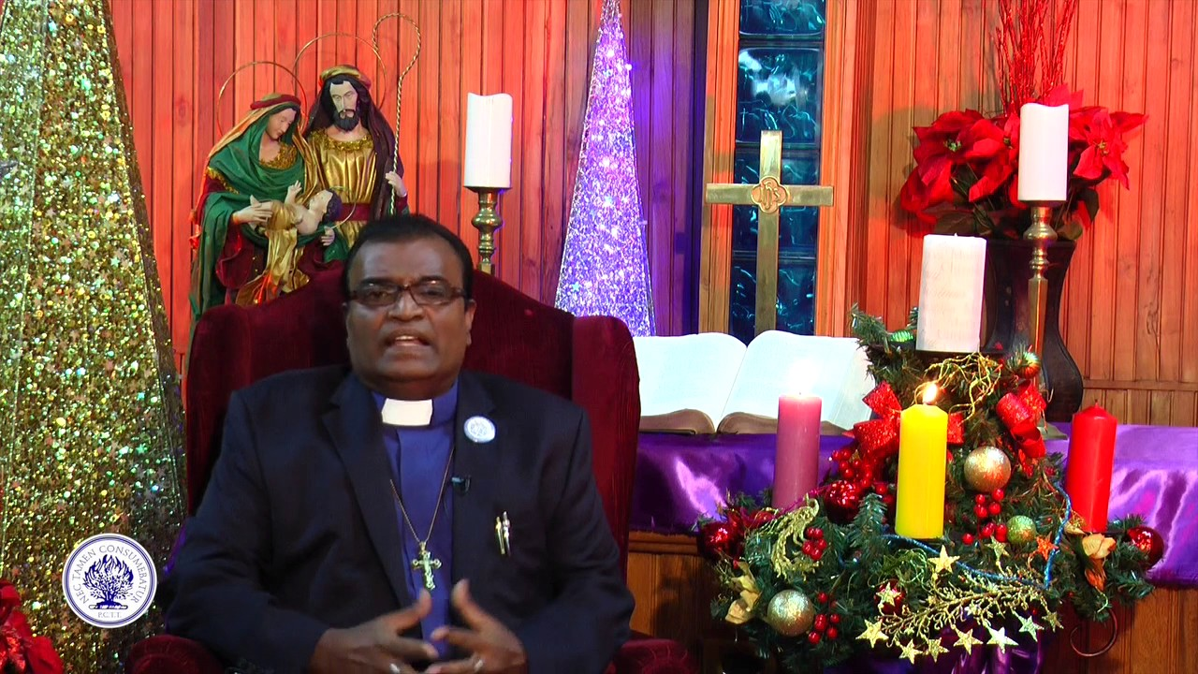
1995 to 2000
Rev. Stephen Harripersad

Slide 19
2000 t0 2005
Rev. Rawle Sukhu
Rev. Ian Gajadhar
Rev. A. Nobbee
Rev. A. Sharma
All served as interim ministers.

Slide 20
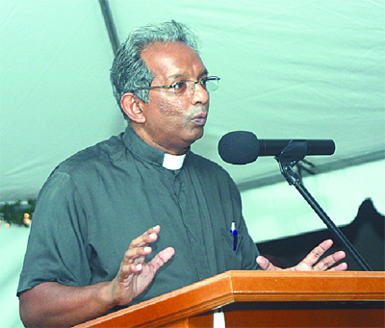
2005 to 2010 –
Rev. Doctor Randall Sammah

Slide 21

2010 to 2014 –
Rev. Kendrick Sooknarine

Slide 22
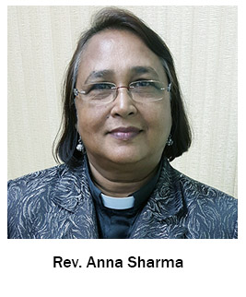
2010 to 2019
Rev. Anna Sharma

Slide 23
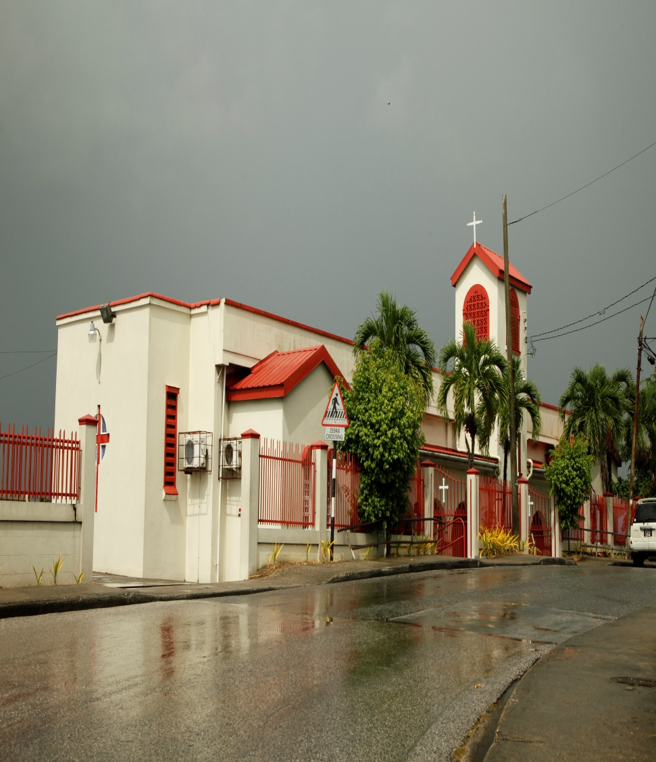
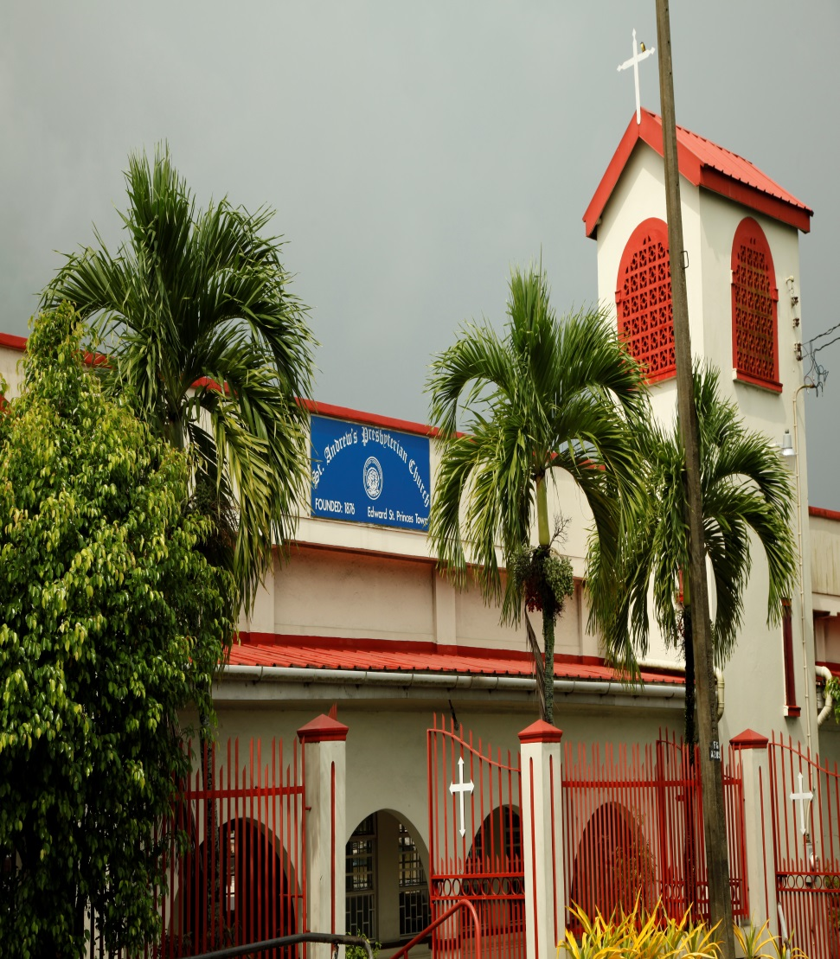
The Current Building

Slide 24
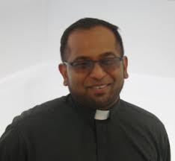
Our new Minister
Rev. Keron Khellawan

Slide 25
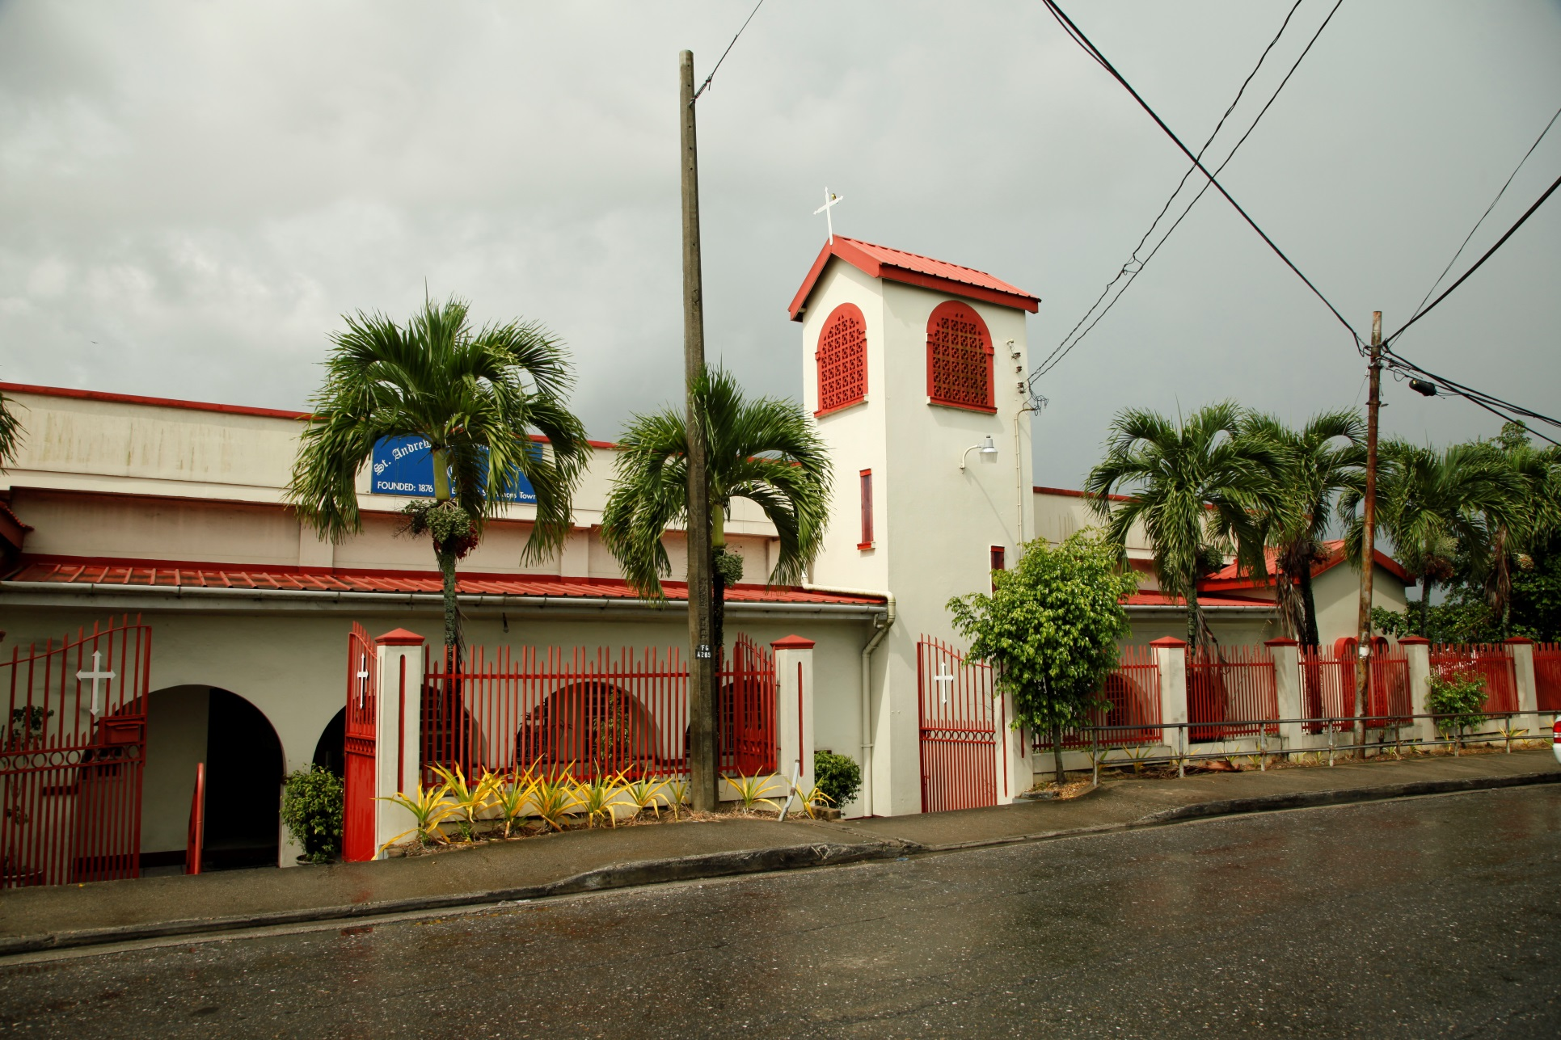

Slide 26
Thank You
To all who served and
To those who continue to serve
May God Bless You Always

